Slide 1
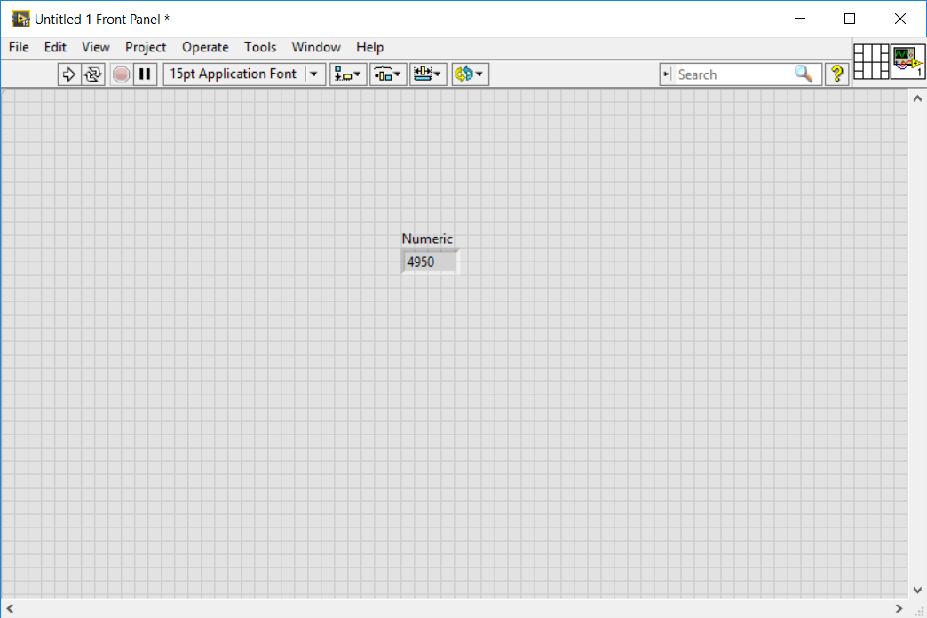
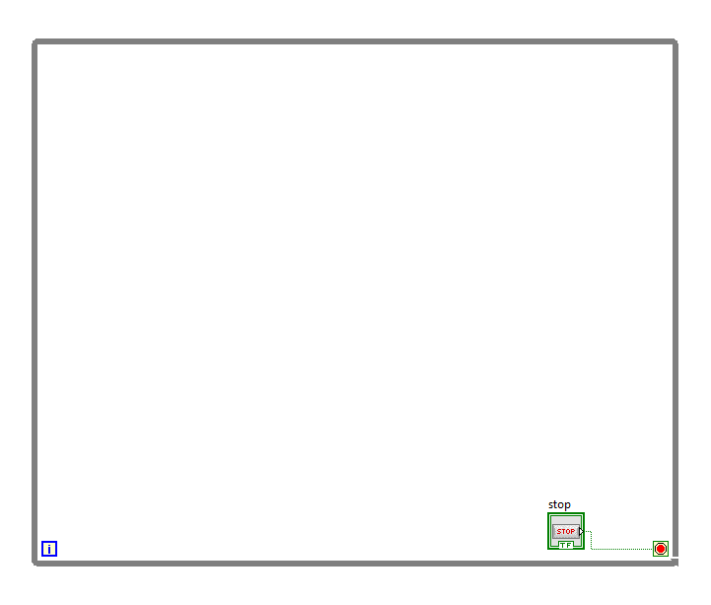
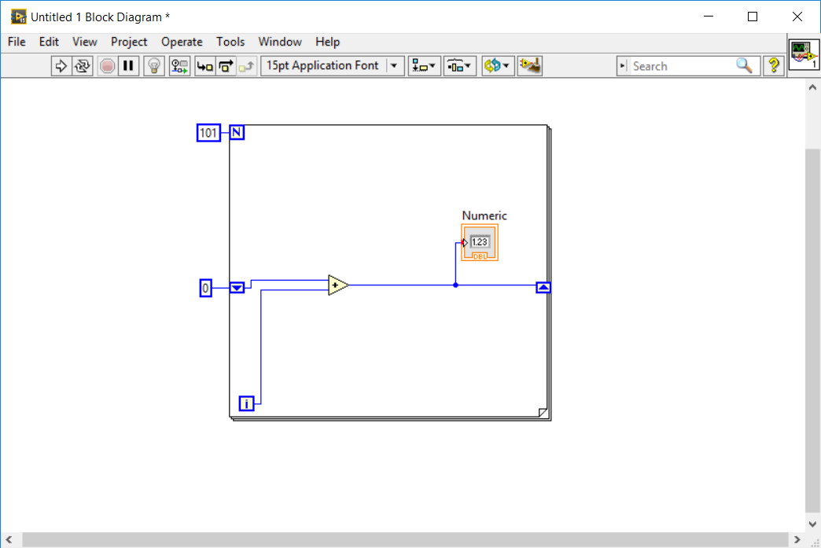

Slide 2
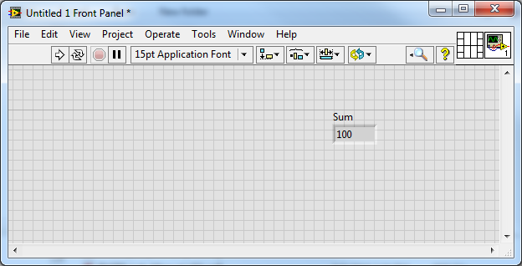
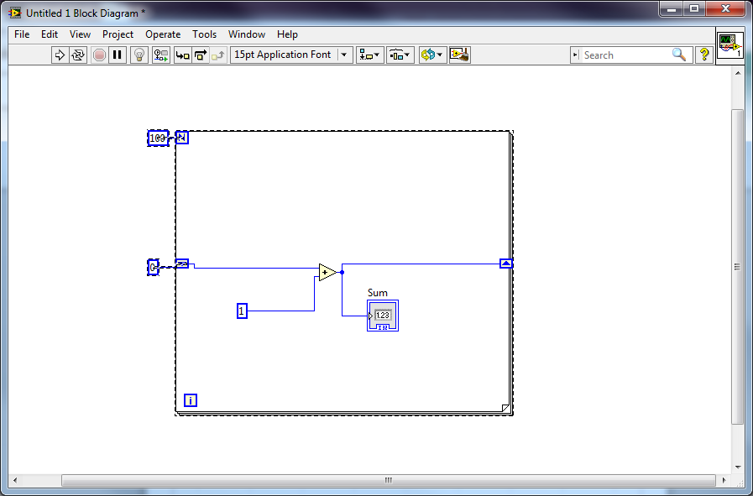

Slide 3
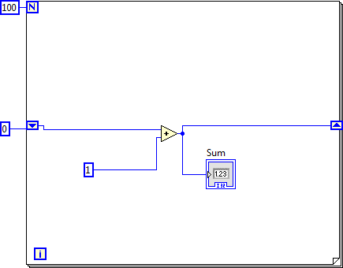

Slide 4
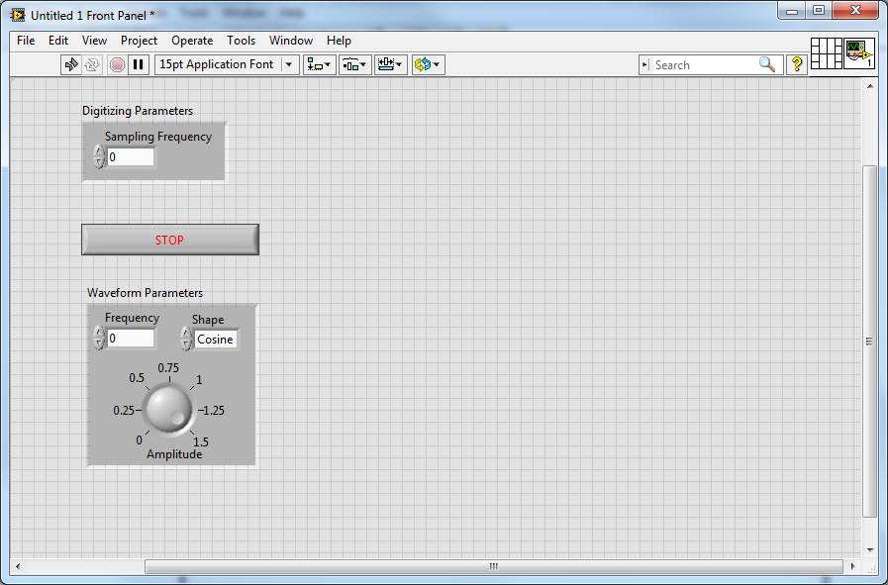

Slide 5
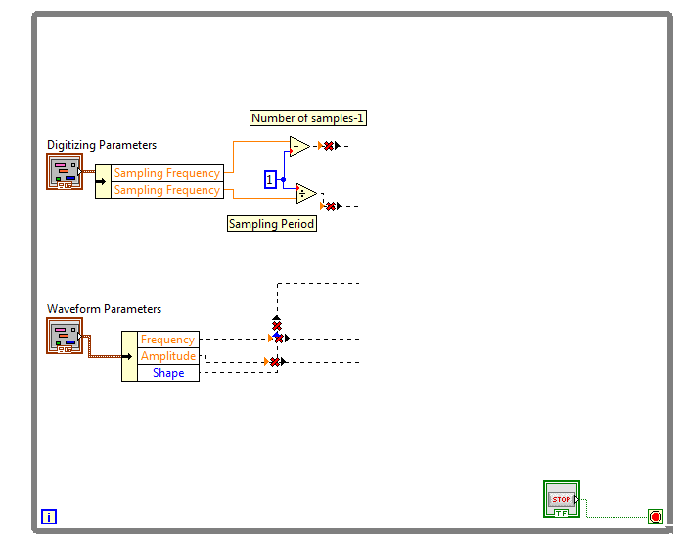

Slide 6
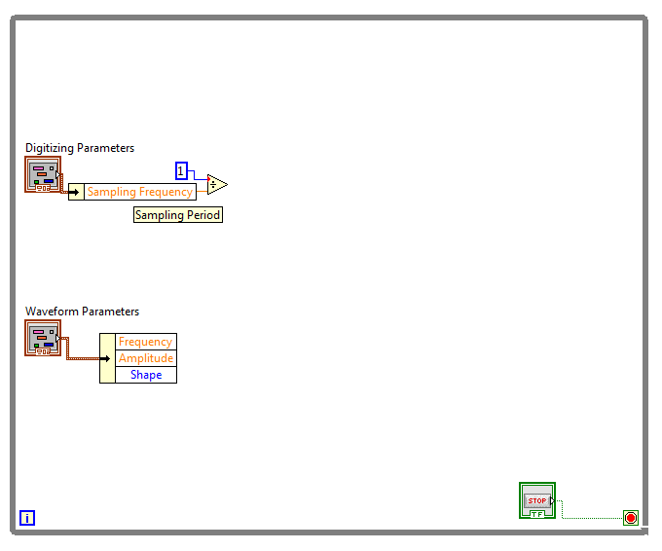

Slide 7
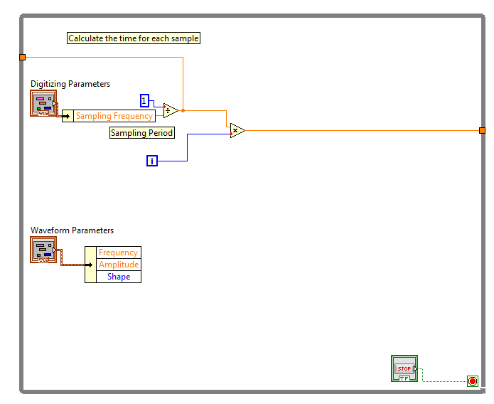

Slide 8
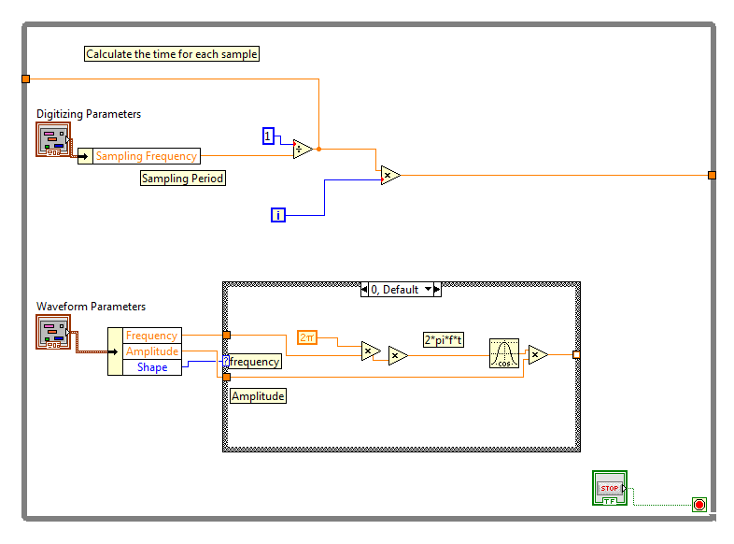

Slide 9
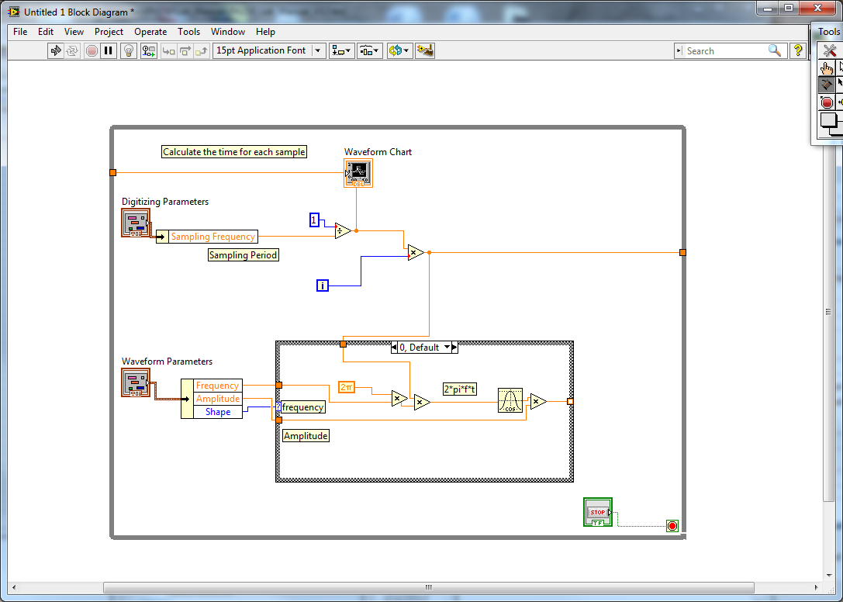

Slide 10
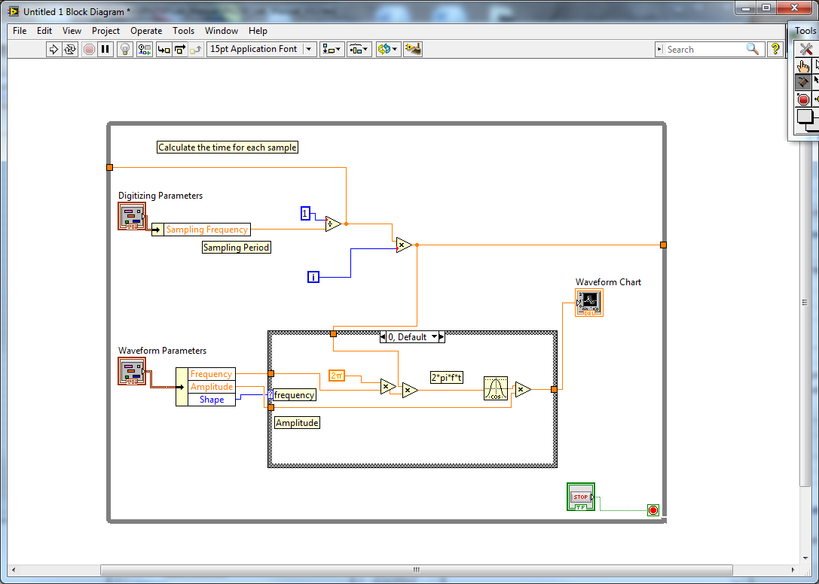

Slide 11
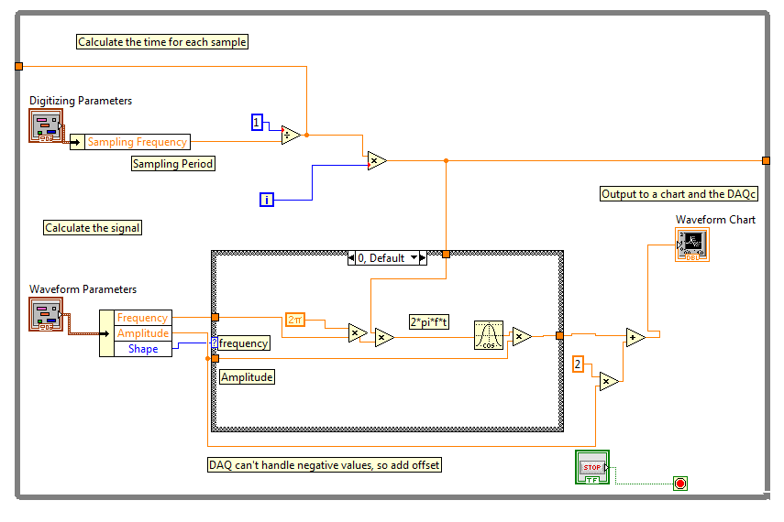

Slide 12
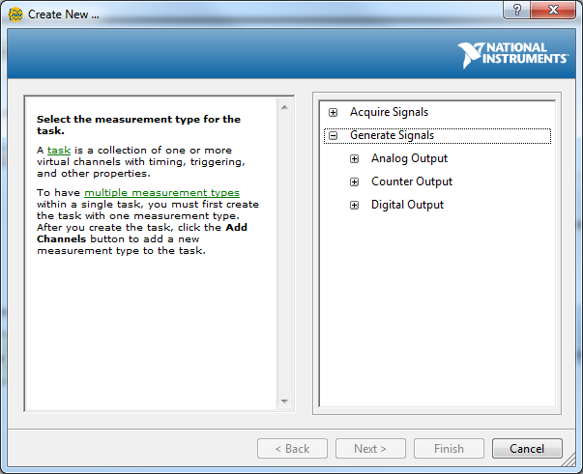

Slide 13
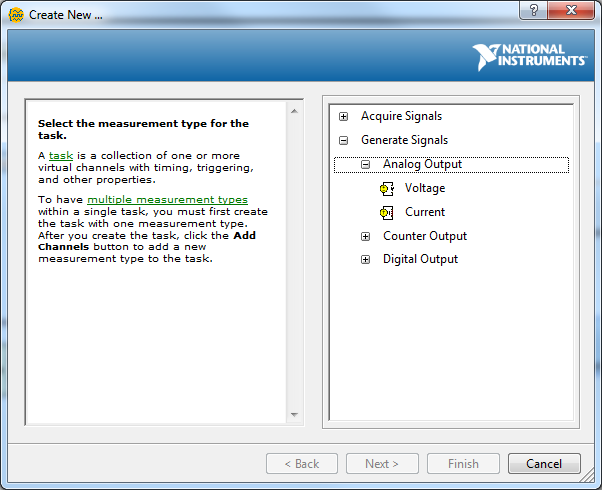

Slide 14
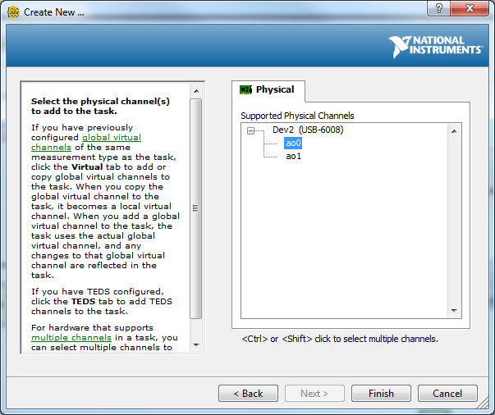

Slide 15
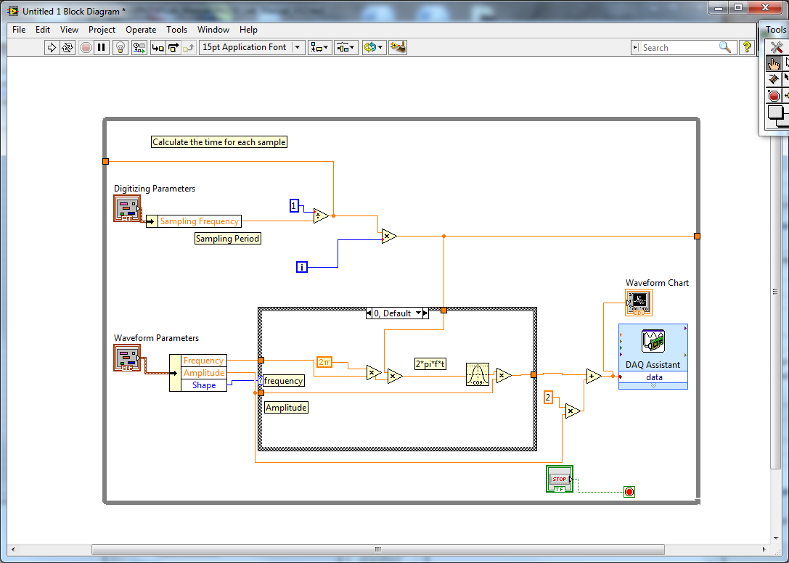
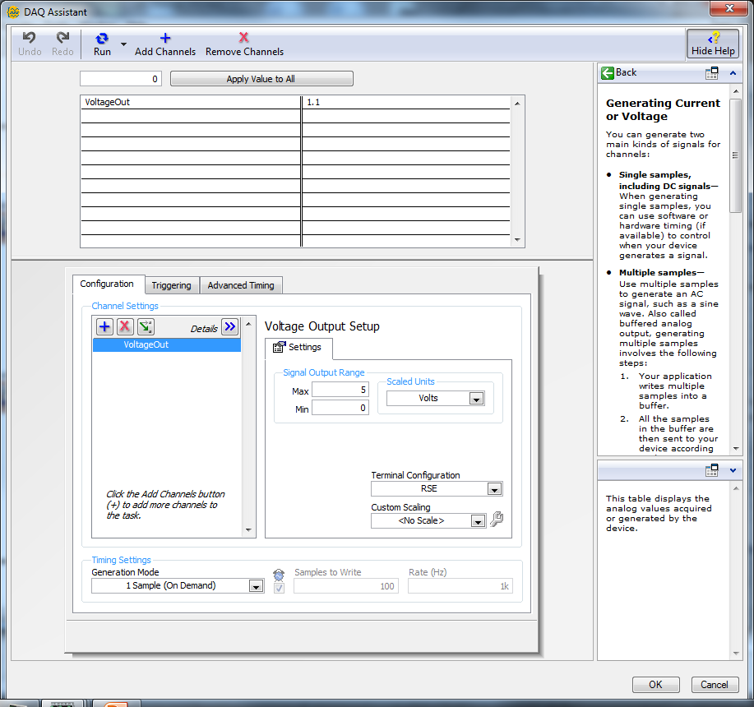

Slide 17
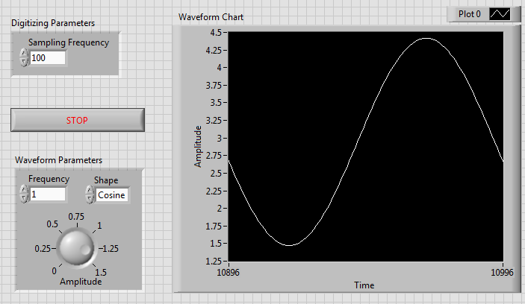

Slide 18
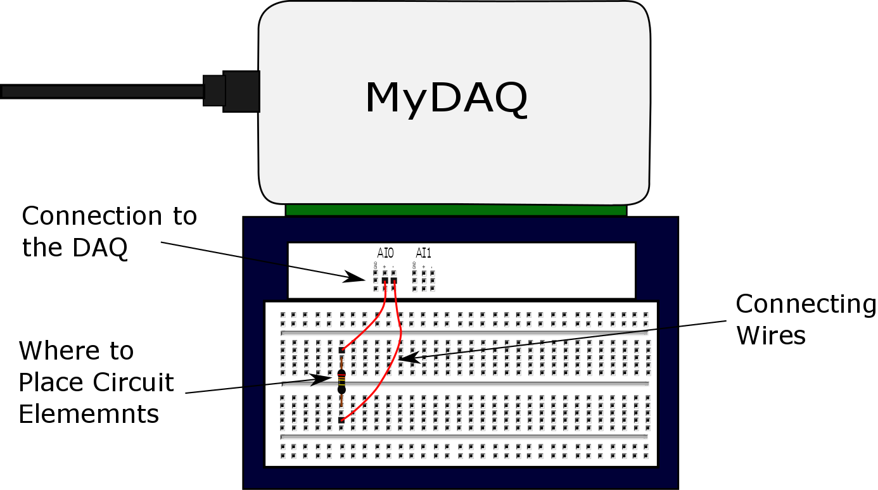
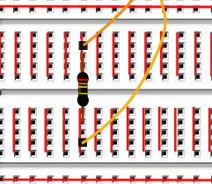
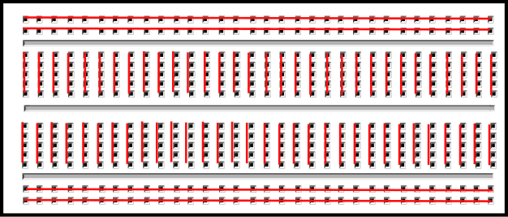
These two wires are connected
These two wires are connected

Slide 19
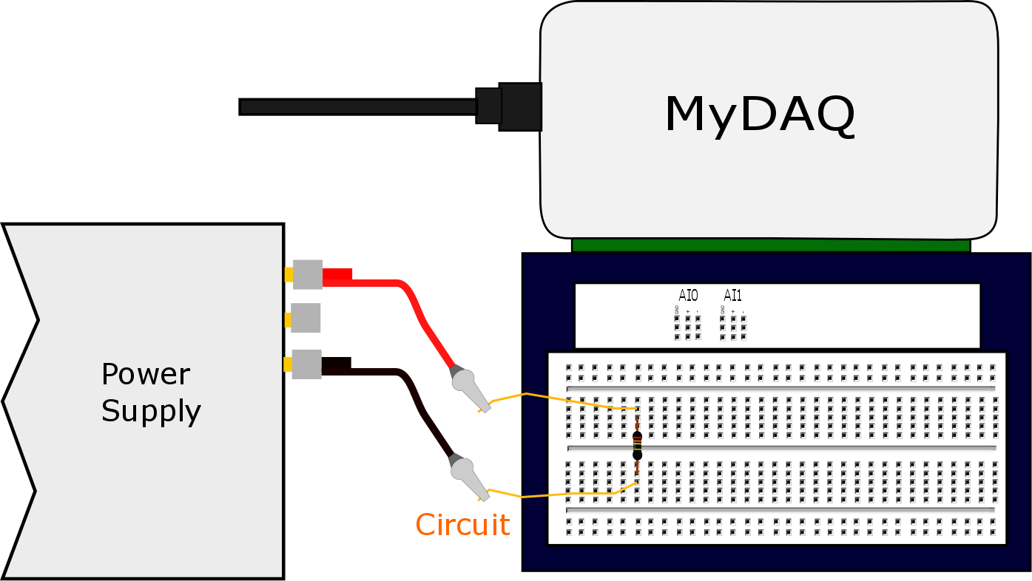
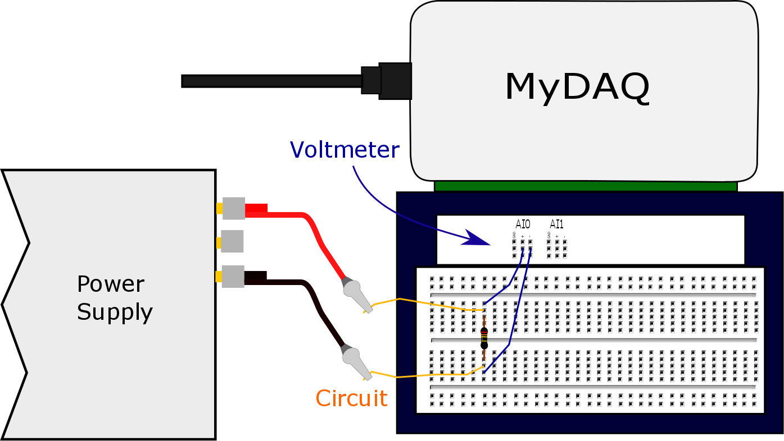
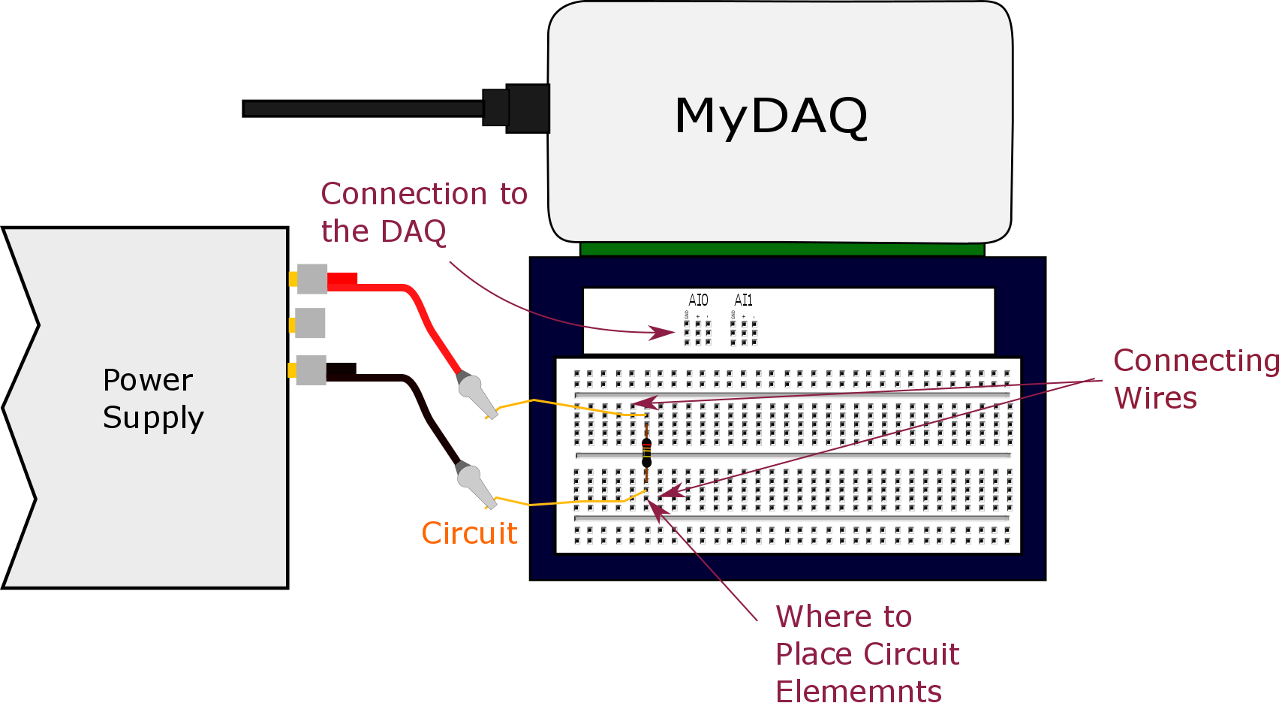

Slide 20
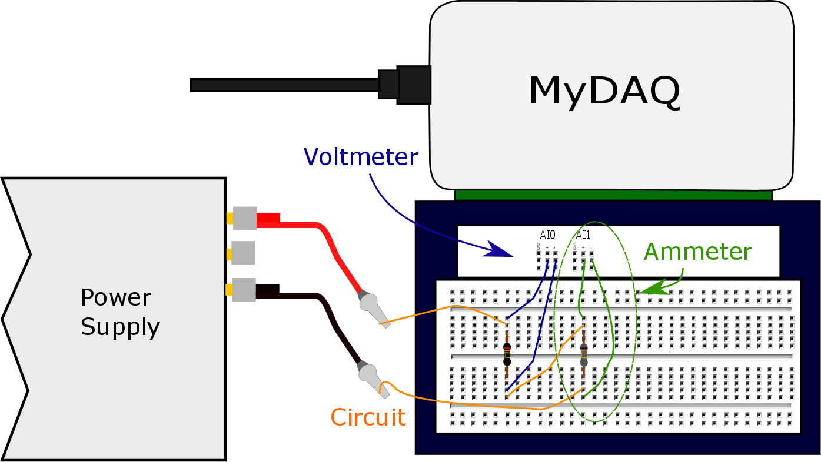

Slide 21


R
R₁
Δv
R₂
Measure

Slide 22

U_{g top}
ΔU_{g} = U_{g top}- U_{g bottom}
U_{g bottom}

Slide 23
V_{top}
Battery
Resistor
ΔV = V _{top}- V _{bottom}
V _{bottom}

Slide 24
5V
1024 divisions
Each division
Is 4.9mV
4.9mV
0V
4.9mV

Slide 25
4.9mV
4.9mV
6mV
4.9mV
0V

Slide 26
V_{top}
Battery
Resistor
ΔV = V _{top}- V _{bottom}
V _{bottom}

Slide 27
WARNING
If done wrong this step can destroy your Arduino

Slide 28
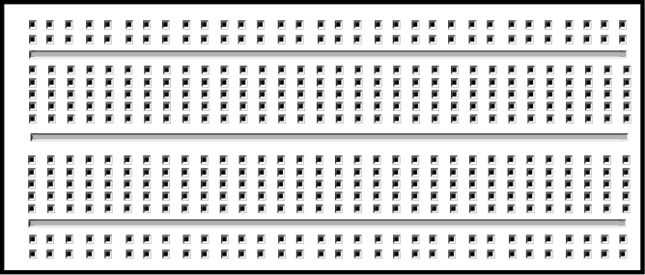

Slide 29
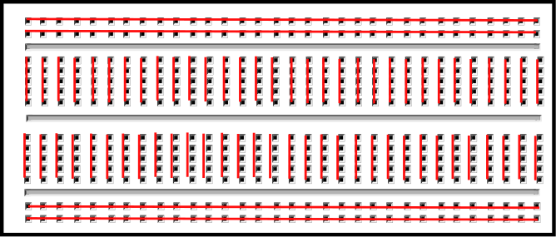
Usually used for positive and negative input voltages.

Slide 30
ΔU

Slide 31
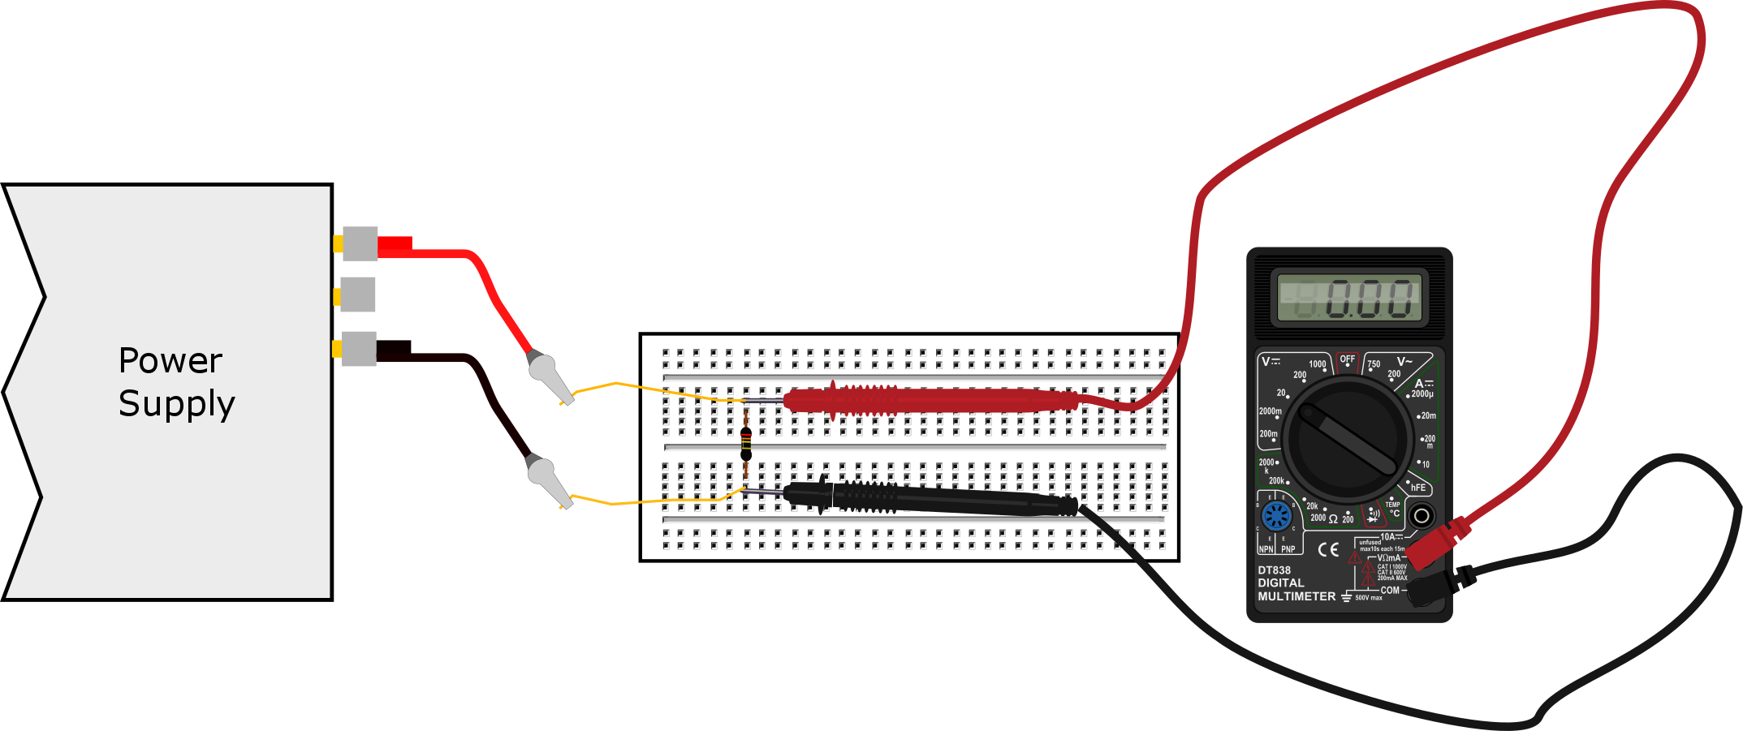

Slide 32
1V
2V
Voltage scale for Channel 1 (red) says 2V
-1V

Slide 33
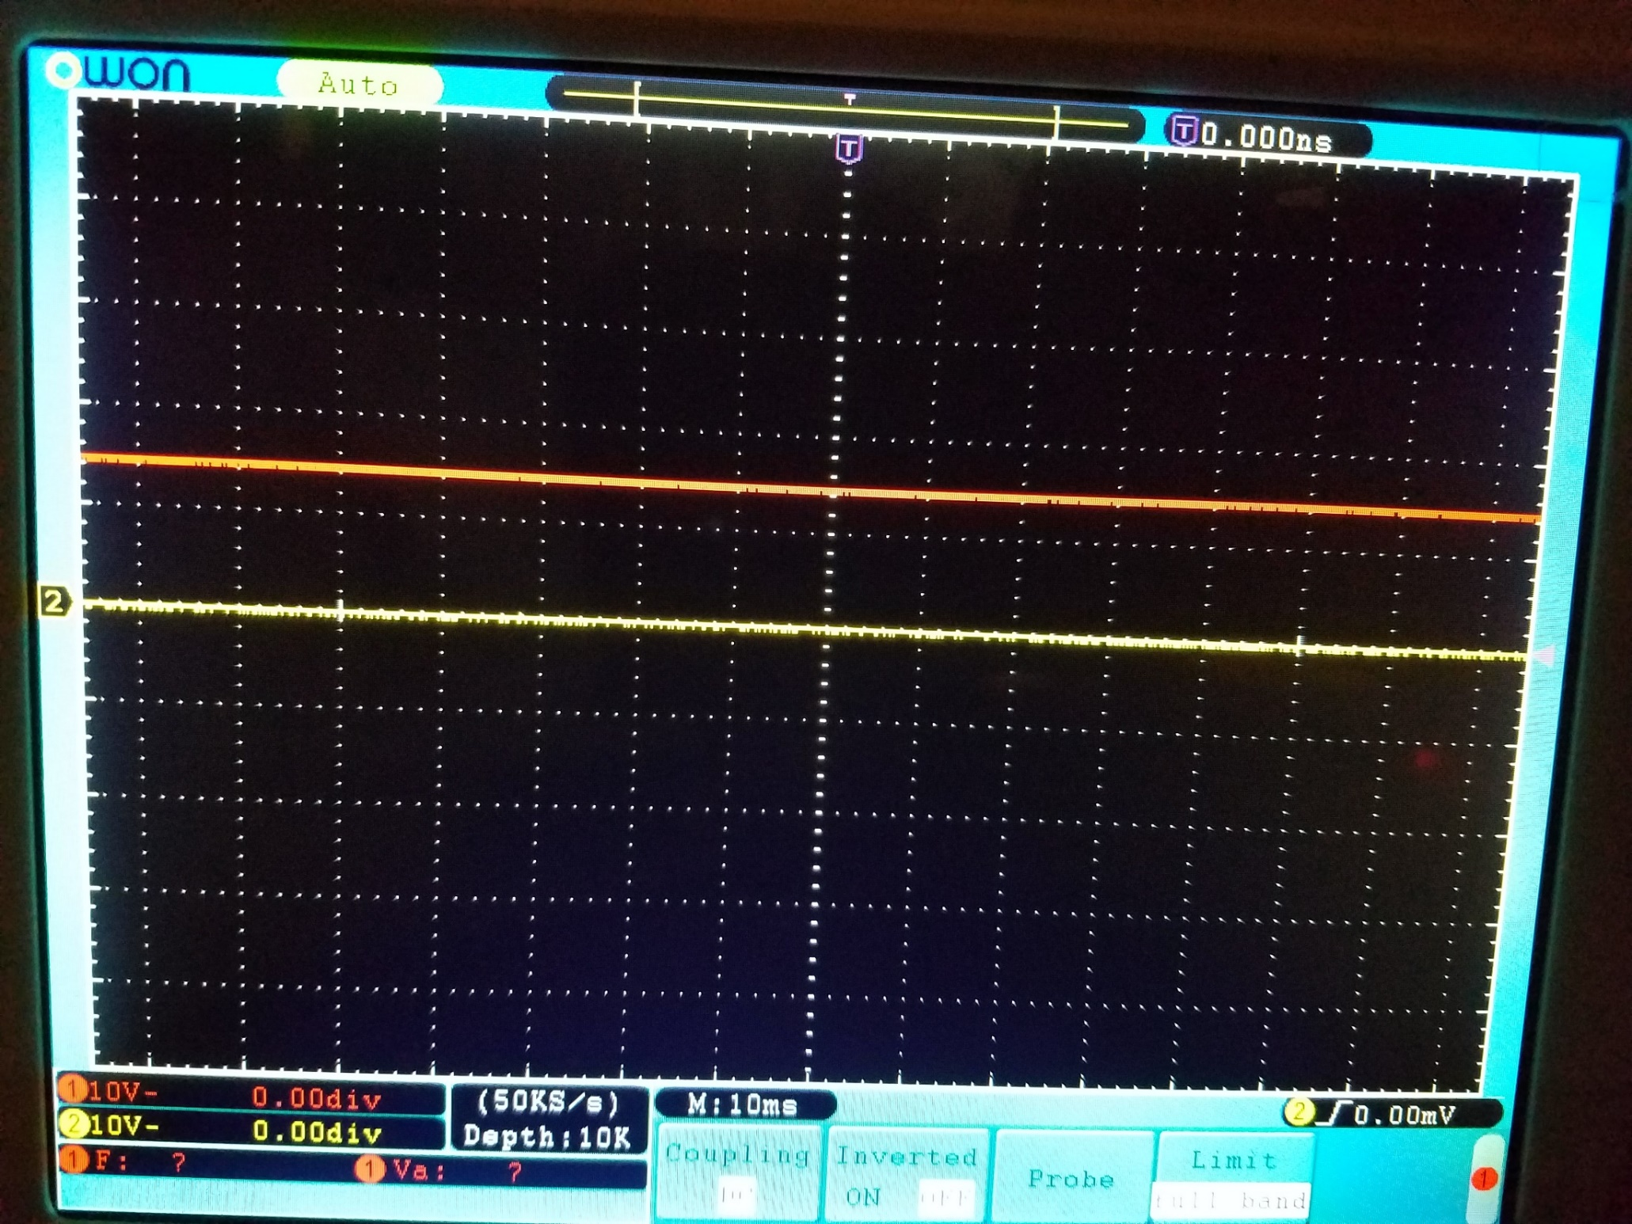

Slide 34
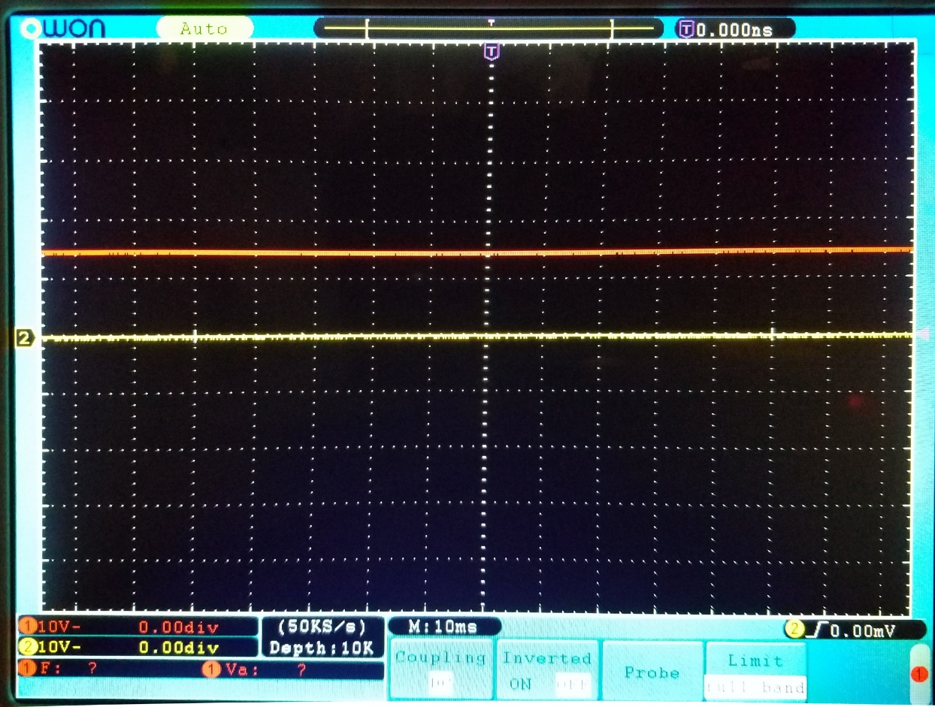
5V
1.5 V signal from a battery
10V
Voltage scale for Channel 1 (red) says 10V
-5V

Slide 35
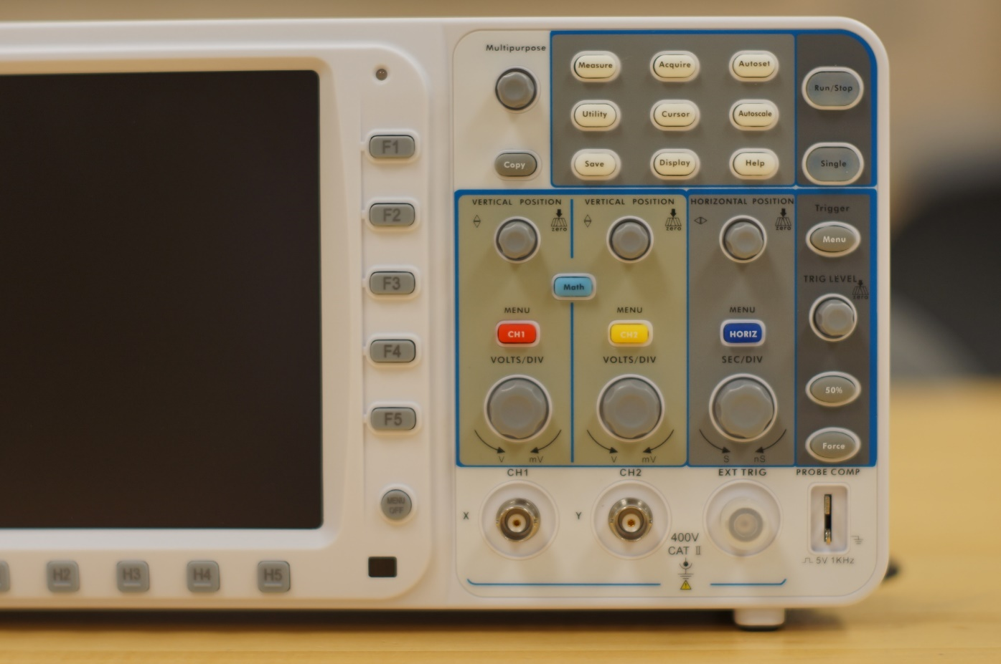
Calibration source

Slide 36
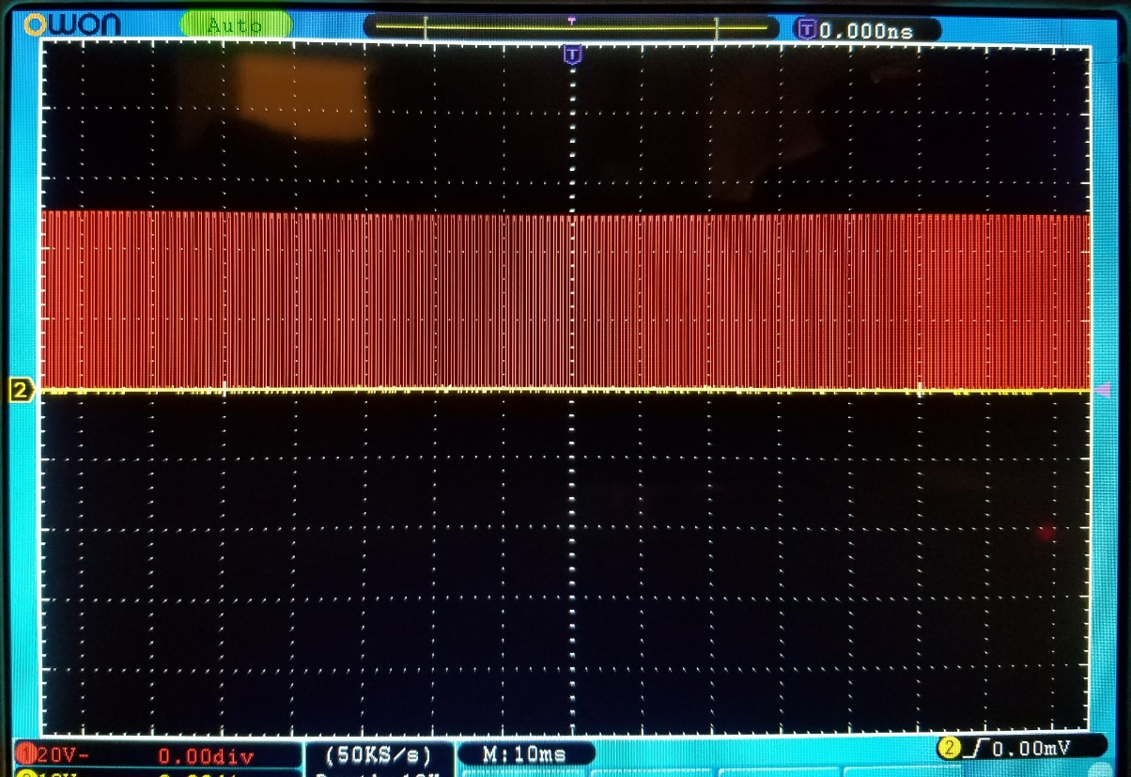
10V
5 V signal from O-scope
Calibration
Source
20V
Voltage scale for Channel 1 (red) says 20V
-10V

Slide 37
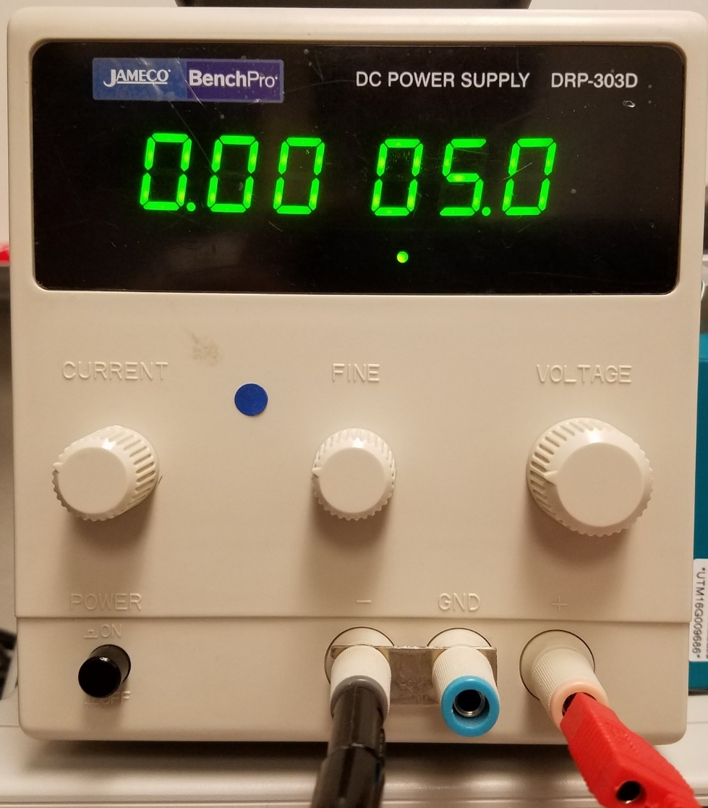
Rough Voltage Indicator
Rough Current Indicator
Voltage
Course Adjust Knob
Current
Limiter
Adjust
Knob
Voltage
fine Adjust Knob
Power Switch
Negative Voltage Out (GND)
Positive Voltage Out

Slide 38
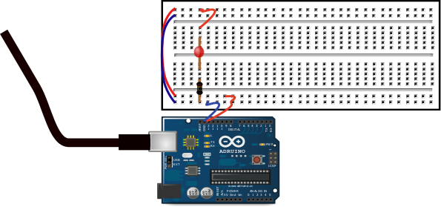
To Computer

Slide 39
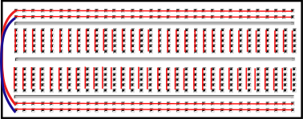

Slide 40
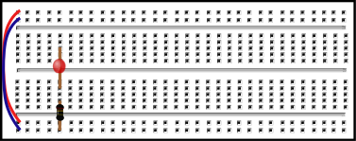
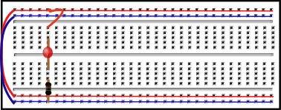
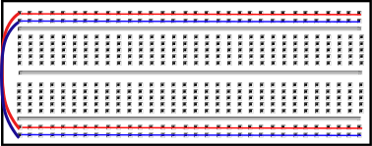
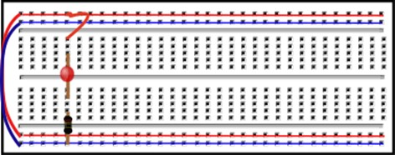
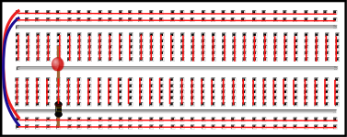

Slide 41
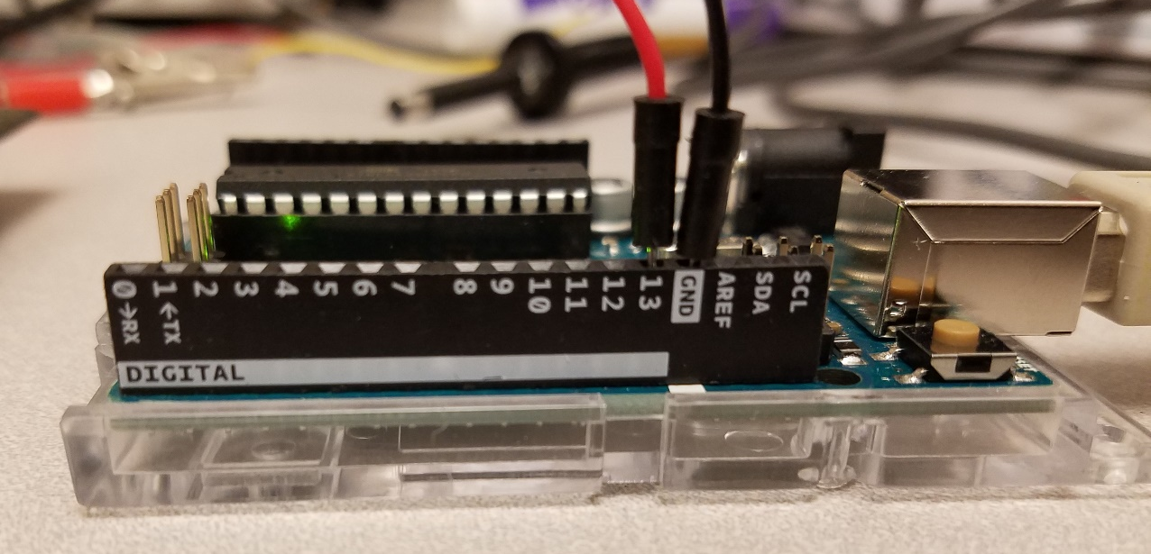
Pin 13
Ground

Slide 42
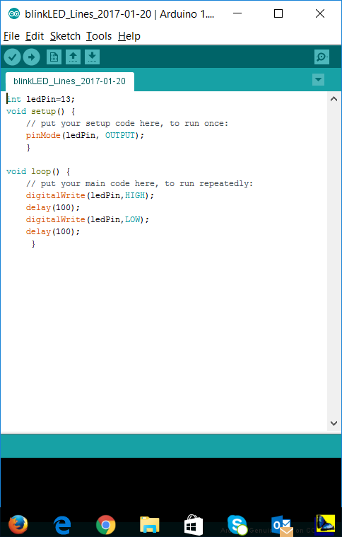
Upload to Arduino
Compile

Slide 43
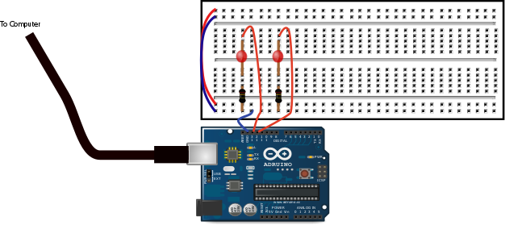

Slide 44
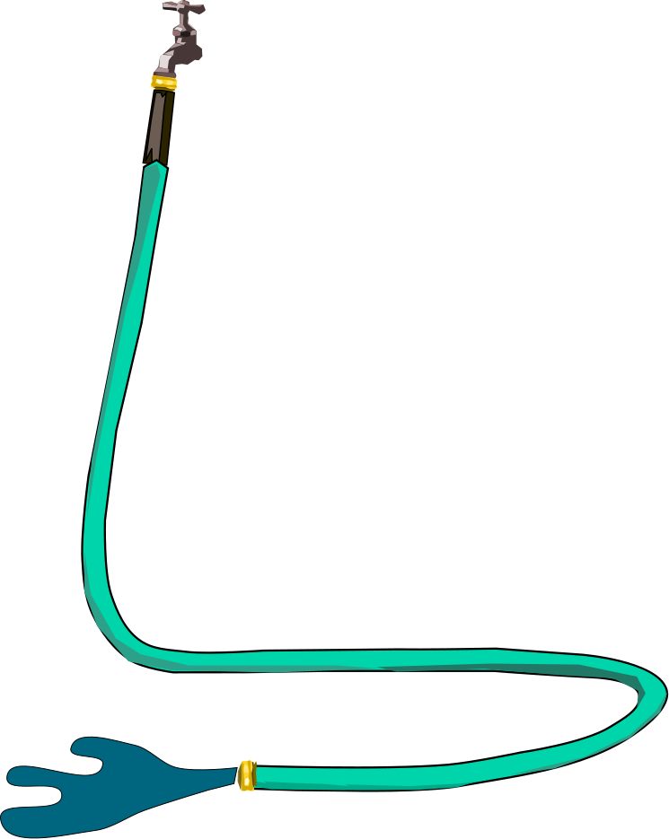

Slide 45
A
Battery
Resistor

Slide 46
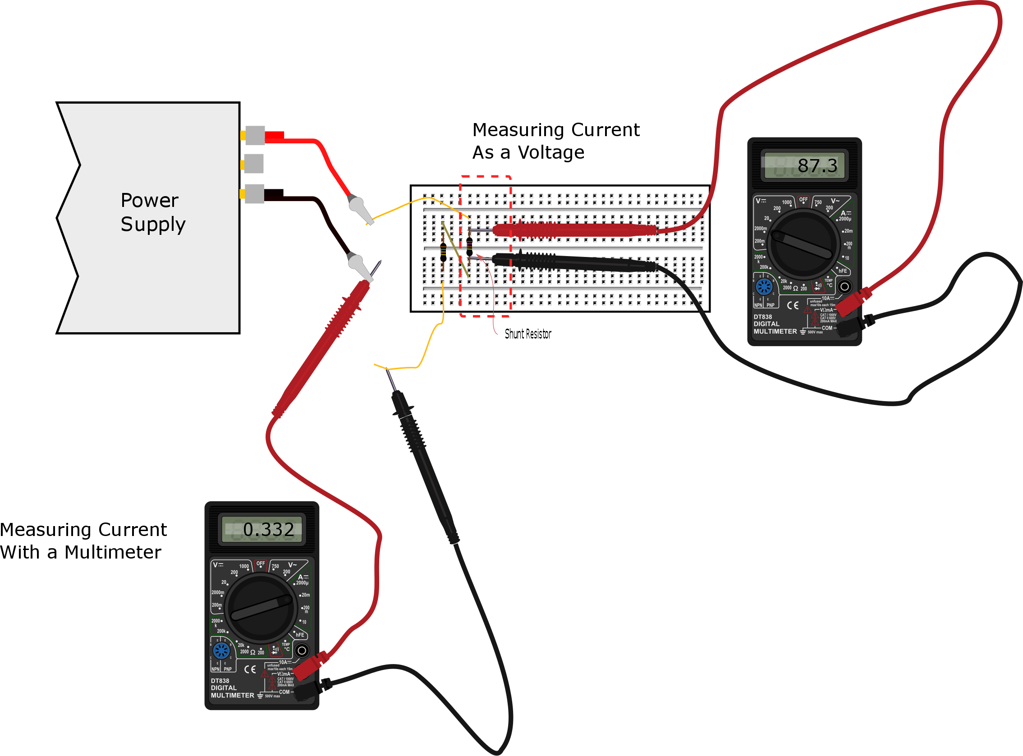

Slide 47
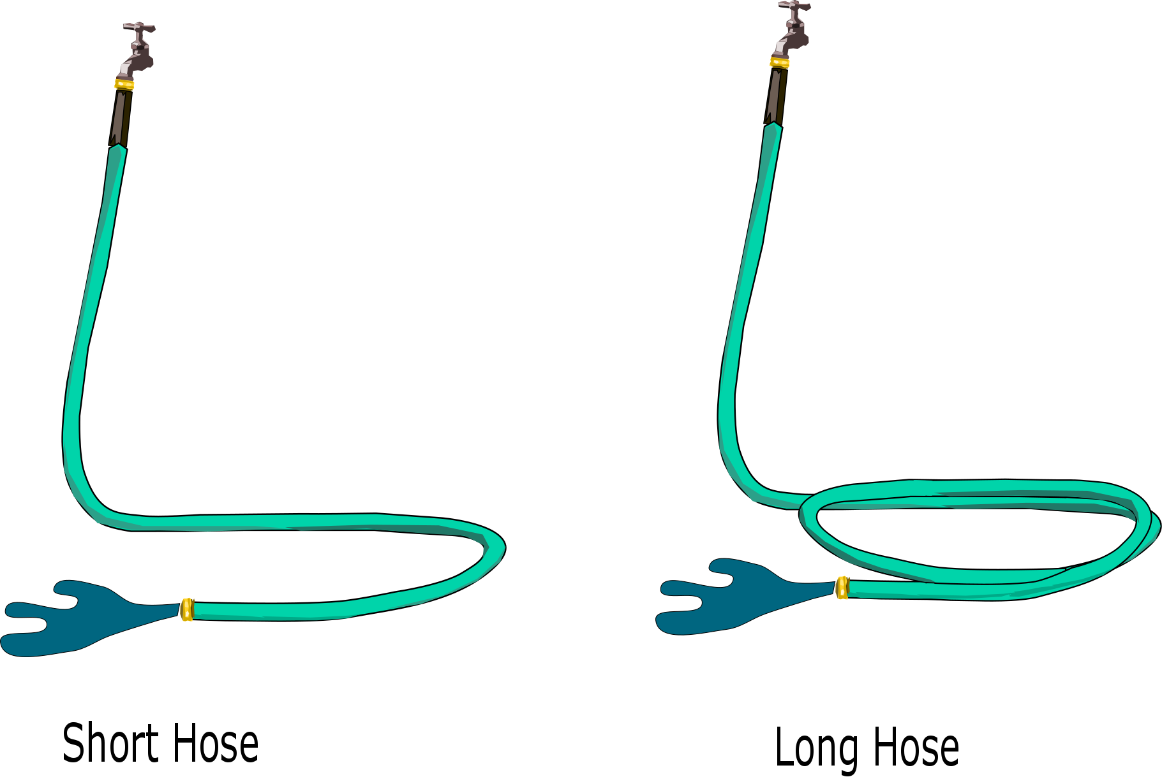

Slide 48
R
R₁
Δv
A0
R₂
Measure
GND

Slide 49
R
Δv
R

Slide 50
From the Power Supply
+5V
R
R₁
A0
R₂
From the Signal Generator
±5V

Slide 51
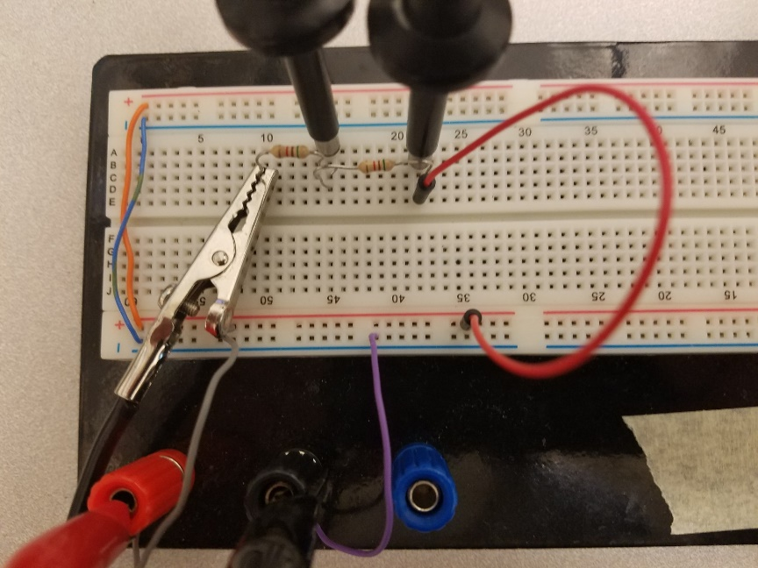
Oscilloscope lead measuring in between the two resistors
Oscilloscope lead measuring the signal generator signal.
+5V from the Power Supply
R₁
R₂
±5V from the Signal Generator

Slide 52
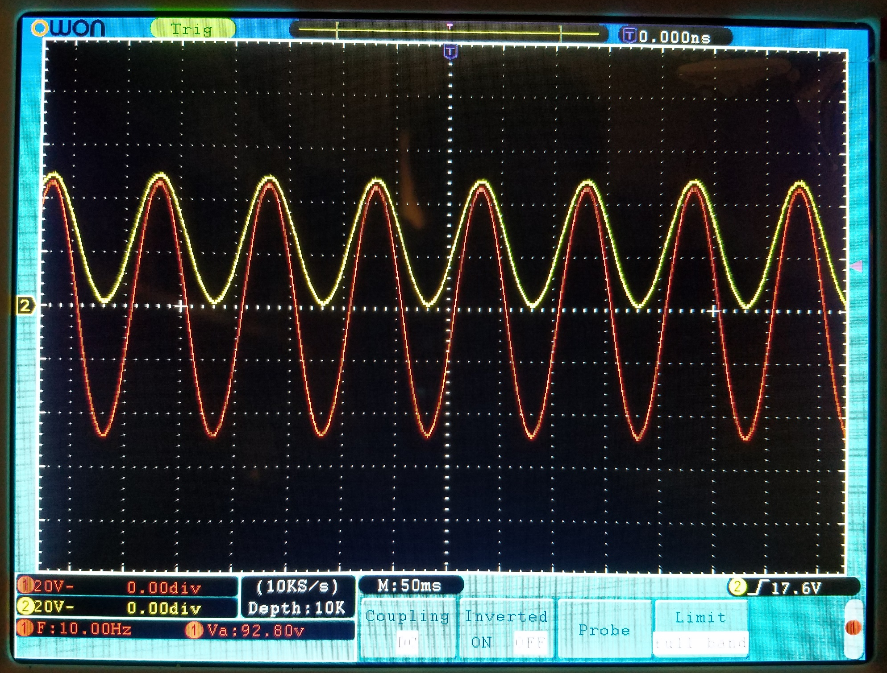

Slide 53


Slide 54


Slide 55




Slide 56
R₂
R₁
V_{in}
-
+
V_{out}
V_{bias}
R₁
Δv
A0
R₂
Measure
GND

Slide 57


Slide 58


Slide 59


Slide 60


Slide 62



Slide 63




Slide 64


Slide 65


Slide 66

To run the code push here
Put our Python
Code here

Slide 67

Messages and data show up here while the code runs

Slide 68


